Slide 1

Chapter 7
SYSTEM Implementation and Testing

Slide 2
The purpose of system implementation is
- to build a properly working system,
- install it in organization,
- replace and old systems,
- preparing system and user documentation and
-train users.
Overview of system implementation
Coding
Testing
Installation
Documenting the system
Training

Slide 3
Terminology
No | Word | Definition
1 | Coding | A process whereby the physical specifications created in the previous phases are turned into working computer codes by the programmer team
2 | Installation | the process of moving from the current system to the new or enhanced system
3 | Integration testing | A testing where it involves two or more modules that link each other
4 | System implementation | A development, installation and testing of system components and delivery of that system into production
5 | System testing | A testing where the it involves the integration of the whole programs into a system
6 | Unit testing | A testing done at the individual level of program or module
7 | User documentation | Written or visual information about system; on how it works, and how to use it.

Slide 4
OVERVIEW OF SYSTEM IMPLEMENTATION
is the development, installation and testing of system components and delivery of that system into production (Bentley et. al., 2007).
The purpose of system implementation is to build a system, install it, replace and old systems, preparing system and user documentation and train users.
During this phase, it’s also involved closedown the entire project.

Slide 5
Five Activities in the System Implementation Phase
System
Planning
System
Analysis
System
Design
√ Coding
√ Testing
√ Installation
√ Documentation
√ Training
System
Implementation
System
Maintenance

Slide 6
Coding
Coding is the process whereby the physical specifications created in the previous phases are turned into working computer codes by the programmer team. Coding is an activity where all the designed during the previous phases will be programmed using a software that have been defined before.
During the coding, each program module will be tested individually, then as part of a larger program, and as the complete system.
At the same time, the team should come out with a system and user documentation to help users in using the system.

Slide 7
Coding (Coding)-sub activities
Involve system analyst, programmer, system designer and database administrator
Network building and testing
  Only needed if the system requires a new or upgraded network.
  Should be done before database and software development.
  Often skipped if the existing network is sufficient.
  Modern systems are typically web-based or intranet-based.
Database building and testing
  A crucial task, as databases store all system data
  Must be done before writing programs because programs rely on database structures.
  Needed if a new or updated database is required.

Slide 8
Coding (Coding)-sub activities
Install and Test New Software
  Applies when the system needs new software purchases or leases.
  This software should be installed and tested after setting up the database..
Write and Test New Programs
  Involves actual coding of the system.
  Begins only after the network, database, and required software are in place.
  Often uses a prototyping approach for development.

Slide 9
Answer TRUE or for FALSE for each of the questions below.
Coding is the process whereby the physical specifications created in the previous phases are turned into working computer codes by the programmer team.
There are several sub activities involved during coding and all this activities are compulsory.
Most of the system developed is around the existing network, so, no need to build and test a network.
Database installed should be tested.
Most of the organizations are prefer to use prototyping when develop a system.

Slide 10
SYSTEM TESTING
Program Testing Process
Initial Testing by Programmer
Each program is tested to ensure it works properly.
Group Testing
Programs are combined and tested together to check how they interact.
System Testing
The entire system is tested to ensure everything works as a whole.
Testing Steps:
Compilation: Detect and fix syntax errors.
Unit Testing: Test individual components or modules.
Integration Testing: Test combined modules for proper interaction
System Testing: Test the full system in its environment.

Slide 11
Unit Testing
Also called module testing.
Performed on individual programs or modules.
Aims to detect:
  Execution errors (e.g., crashes)
  Logic errors missed during desk checking.
Each program is tested independently, especially those that interact with files or other programs.

Slide 12
Integration Testing
Performed after unit testing.
Tests multiple modules working together.
Ensures that interactions between modules function correctly within the system.
First, we need to test the root module and only one of the subordinates. After that, we need to test another two subordinates module from the same level. The same process goes until for the next level. We continued this testing until the whole system is tested as a unit.

Slide 13
System Testing
After completing the integration testing, which involves the entire system.
It’s similar with an integration testing. The different is, in system testing, we integrate programs into system.
After the system testing is completed, we can assume that the system is fully tested and are free any errors or bugs.

Slide 14
Exercise
Answer TRUE or for FALSE for each of the questions below.
Unit testing does require automated code execution
Integration testing is the process of bringing together all of the modules that a program comprises for testing purposes.
The focus of integration testing is to make sure that all the interrelated modules are working.
System testing is not compulsory since we have conducted an integration testing.
Once we have finished the system testing, we can proceed with an installation.

Slide 15
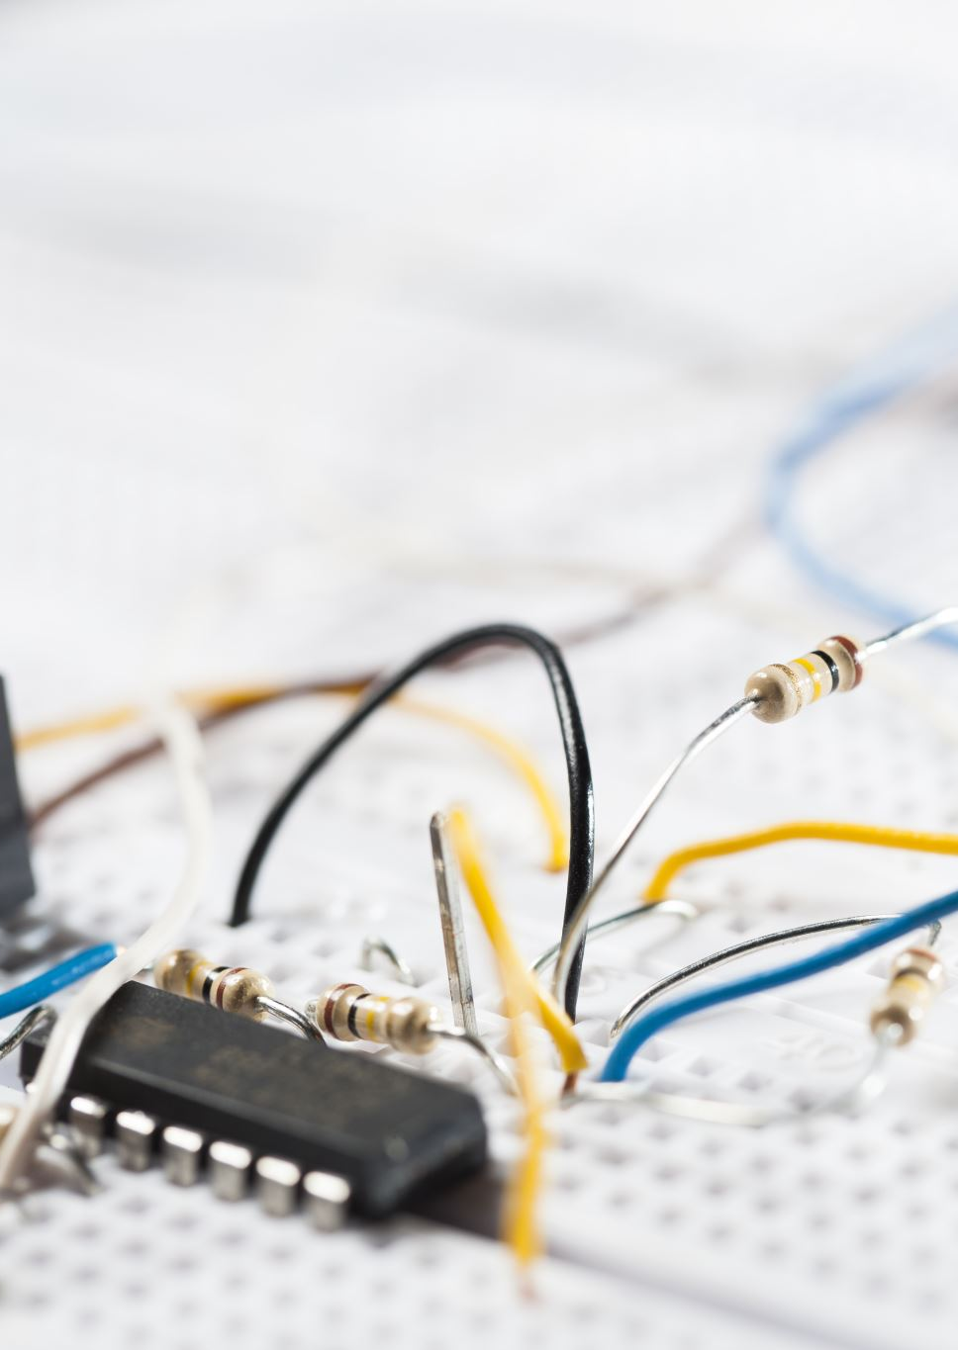
Installation
Installation is the process of moving from the current system to the new or enhanced system. This is also refer to conversion activity; converting an old system to a new system. At this stage, all users must give up their reliance on the current system and begin to rely on a new system. There are four approaches of installation; direct, parallel, single-location and phased installation. Which approaches will be used is depends on the organizations and the system’s scope and complexity.

Slide 16
Direct Installation
The old system is immediately replaced by the new one at a specific date and time.
It is a high-risk approach because any undetected problems in the new system will affect users directly.
If the new system fails, delays may occur until the issues are resolved.
This method is sometimes necessary for policy or deadline-driven changes.
While risky, it can lower installation costs if everything goes smoothly.
Thorough preparation is essential to minimize risk.
Current System
Install New System
New System
Time
Direct Installation

Slide 17
Parallel Installation
Both old and new systems run simultaneously for a period of time.
Considered a low-risk (riskless) approach because issues can be resolved before turning off the old system.
Opposite of direct installation.
Ensures smooth transition and system reliability.
However, it involves high costs (e.g., staff, maintenance).
May cause confusion among users who must work with both systems at once.
Current System
Install New System
New System
Time
Parallel Installation

Slide 18
Single-location Installation
The new system is tested at one site (e.g., a branch or department) before full rollout.
Can use either direct or parallel installation at the pilot site.
It is a moderate-risk approach, sitting between direct and parallel methods.
Once the pilot is successful, the system is deployed to other locations, often using direct installation.
Advantages:Helps identify and fix issues early.Reduces risk and cost for the full rollout.
Disadvantages:May delay full implementation across the organization.
Current System
Install New System
Location 1
New System
Current System
Install New System
Location 2
New System
Single-location installation

Slide 19
Phased Installation
The new system is installed module by module (functional components), over time.
It is an incremental approach, where parts of the old and new system run together until the full system is in place.
Aims to minimize risk, similar to single-location installation.
Resembles a series of gradual system releases.
Requires:
Careful version control
Repeated conversions for each phase
A longer rollout period
Disadvantages:
Can cause user frustration and confusion due
to ongoing changes.
Current System
Current System without Module 1
Current System without Module 1, …
Install Module 1
Install Module ...
New Module 1
New Module …
Phased Installation

Slide 20

System Acceptance Test
A final evaluation before officially adopting the new system.
Involves end users, management, and IT operations.
Determines whether to accept or reject the system.
Conducted on the completed system.
Includes Three Levels of Testing:
Verification Testing – Ensures the system meets all specified requirements.
Validation Testing – Confirms the system performs correctly in real-world scenarios.
Audit Testing – Checks system accuracy, security, and compliance with policies.

Slide 21
Verification testing
  also refers to alpha testing.
  This testing runs the system in a simulated environment using simulated data. It’s looking for errors and omissions regarding end users and design specifications that were specified in the earlier phase of testing.
Validation testing
  also refers to beta testing. This testing runs the system in a live environment using real data. A number of items tested during this testing such as:
    system performance
    peak workload processing performance
    human engineering test
    methods and procedures test
    backup and recovery testing
Audit testing
  is a test performed to ensure that the system is free from any errors and ready to be placed at the real location.

Slide 22
Exercise
Answer TRUE or for FALSE for each of the questions below.
There are four approaches of installation that can be chosen by organizations; direct, parallel, single-location and phased installation.
Single-location installation is when both system; old and new system are operating at the same time until the management decide that the old system can be turned off.
Phase installation is known as incremental approach where a new system is installed by module.
Verification testing is a test that runs the system in a simulated environment using simulated data.
There is a need to conduct system acceptance test since we can make a final decision about the system.

Slide 23

DOCUMENTING THE SYSTEM
Every system development is unique and need unique documentation. There are two basic types of documentation; system documentation and user documentation.

Slide 24
System documentation
records detailed information about system’s design specification, its internal workings and its functionality (Hoffer et. al., 2005).
is prepared for maintenance person who will in charge the system operating in the future. System documentation can be divided to internal and external documentation.
  Internal documentation
    Internal documentation is part of the program source code or is generated at compile time
  External documentation
    External documentation is a system documentation that includes the outcome of structured diagramming techniques such as data flow and entity-relationship diagrams. Although it don’t cover the code itself, but it can provide useful information to the primary users of system documentation-maintenance programmer

Slide 25
User Documentation
is intended for system maintenance programmer; user documentation is intended for system users. User documentation consists of written and visual information about the system, such as what its function, how its function and how to use it. There are few types of user documentations;
  reference guide - consist of exhaustive list of system functions and commands
  quick reference guide - provide essential information about operating a system in a short, concise format
  user’s guide - provide information on how users can use a computer system to perform specific tasks.

Slide 26
Exercises
Answer TRUE or for FALSE for each of the questions below.
System documentation is a documentation prepared in order to assist users about the system.
Each system requires same documentation.
System documentation records detailed information about system’s design specification, its internal workings and its functionality.
External documentation is part of the documentation contains program source code or is generated at compile time.
System documentation is for system maintenance programmer and user documentation is for system users.

Slide 27
Training
Documentation helps users throughout the system’s life cycle, but training is essential when transitioning to a new system.
Training sessions are usually supported by the prepared documentation.
Users must be trained and guided to use the new system effectively.
Training Methods:
  Can be done one-to-one, but group training is preferred:
    Saves time and cost
    Encourages participation and feedback
Training Content Should Include:
  System introduction
  System manual or user guide

